Slide 1
HIGH SCHOOL

Slide 2
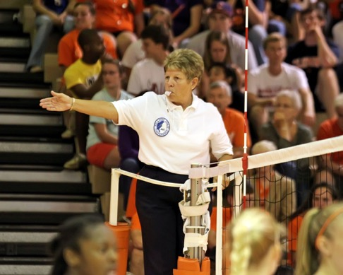
OFFICIATING
Notes:
Average age 57
Need young people
No more pressure than a player

Slide 3
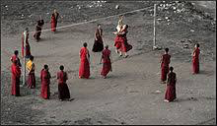
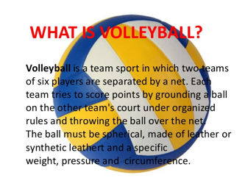
RULES OF THE GAME

Slide 4
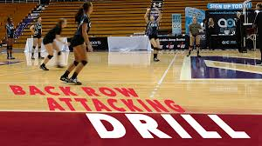
Back Row Players
A back-row player shall not ________?

Slide 5
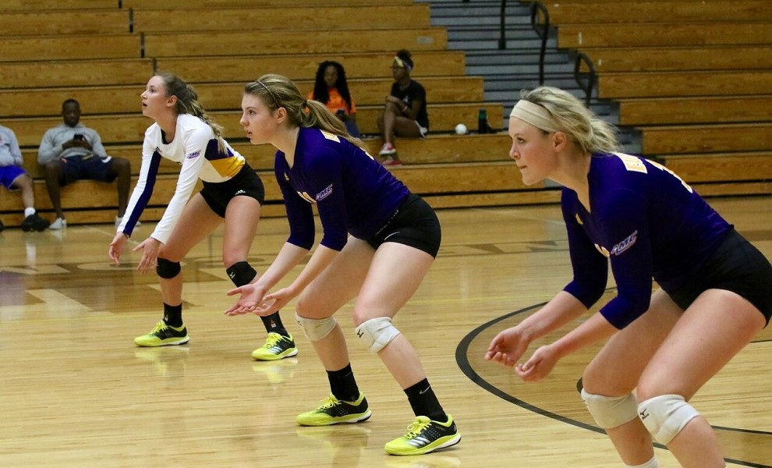
Back Row Players
Rule 9-5-5
A back-row player shall not:
a. Participate in a completed block;
b. Attack a ball which is completely above the height of the net while positioned:
1. On or in front of the attack line or its out-of-bounds extension;
2. In the air, having left the floor on or in front of the attack line or its out-of-bound extension.
NOTE: An illegal back-row attack shall not be called until the ball has completely crossed the net or is contacted by the opponent. (9-4-4)

Slide 6
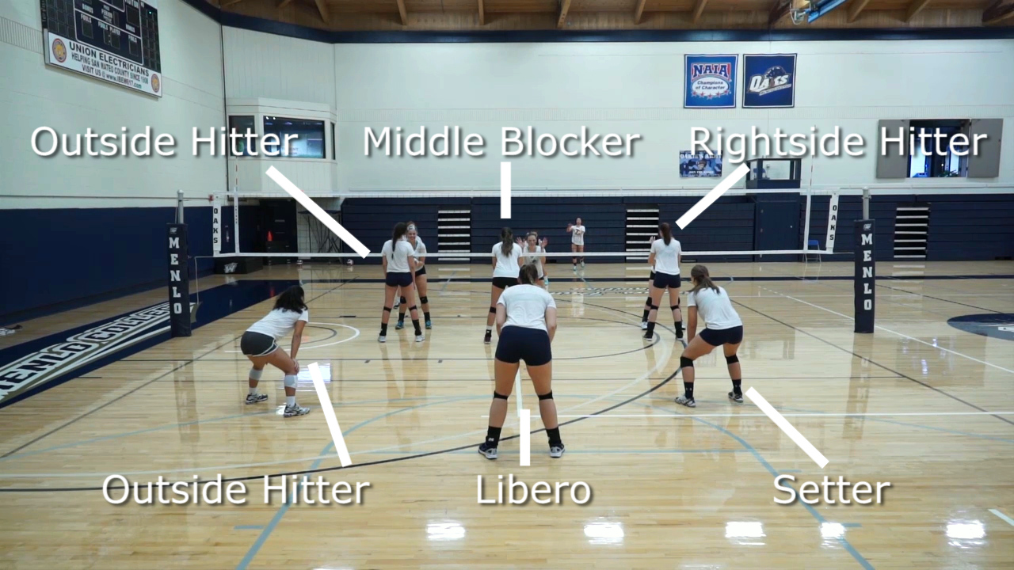

Slide 7
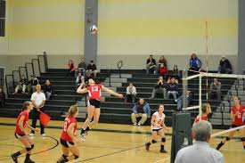
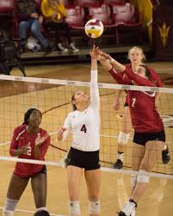
What is a Back Row Attack?

Slide 8
BACK ROW ATTACK
RULE 9-5-3: Back-row players, while positioned behind the attack line, may contact the ball from any position inside or outside the court above or below the top of the net.
Rule 9-5-4: A back-row player (on or in front of the attack line), cannot contact the ball completely above the height of the net and complete an attack.

Slide 10
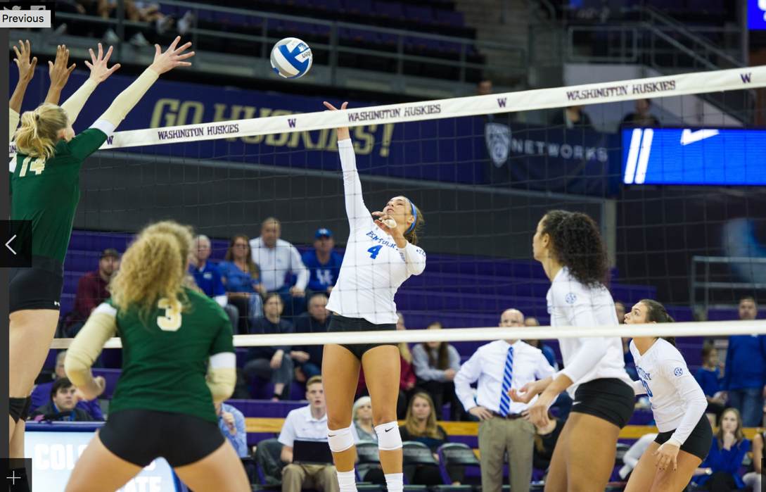

Slide 12
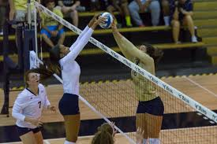
What is the definition of a BLOCK?

Slide 13
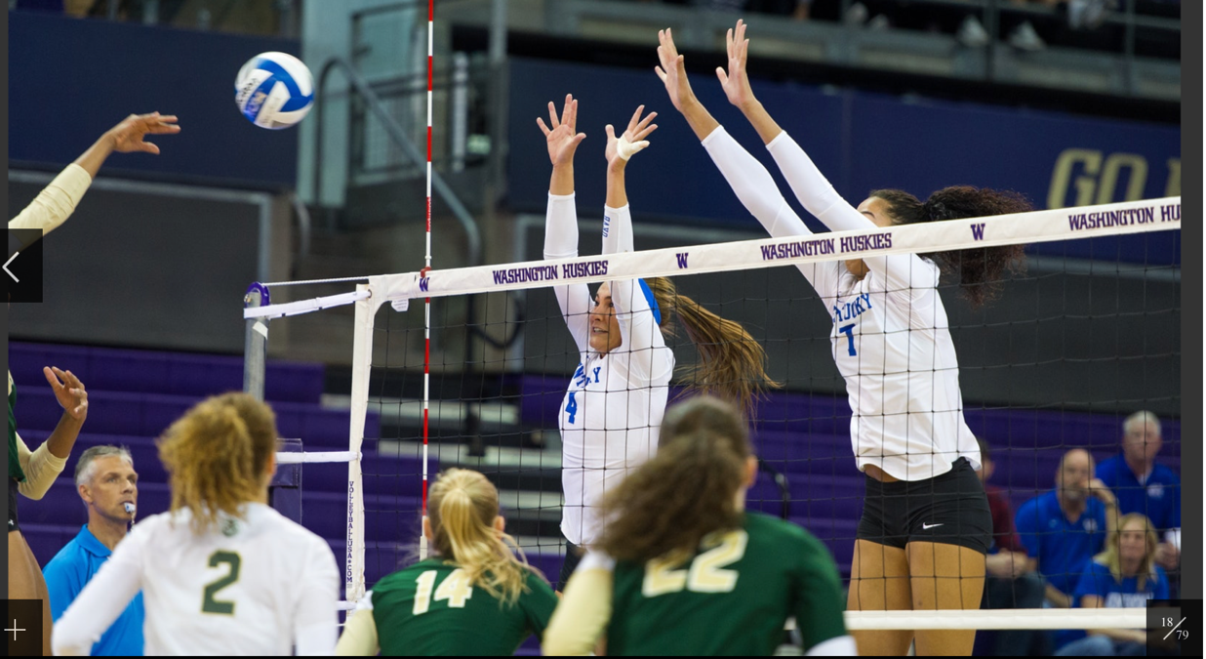
BLOCK
Rule 9-5-1c (Definition)
Block - the action of a player(s) close to the net that deflects the ball coming from the opponent by reaching higher than the top of the net at the moment of contact. A block may involve wrist action provided there is no prolonged contact.

Slide 14
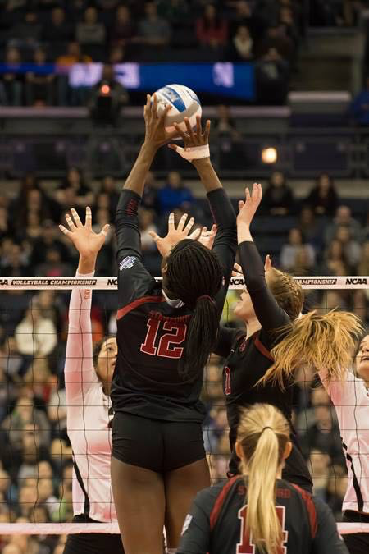

Slide 15
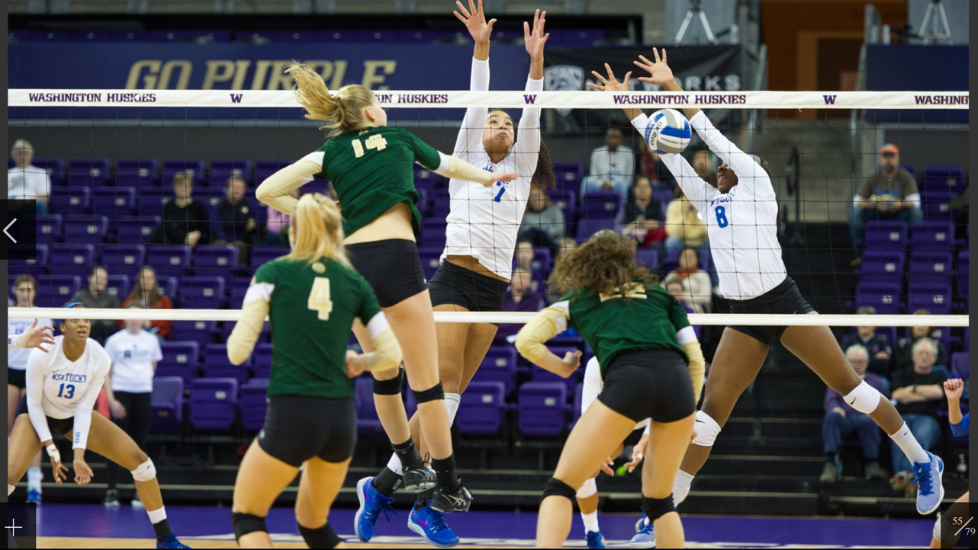

Slide 16
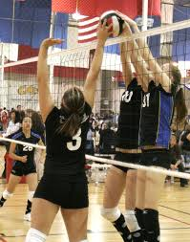
What is a Back-Row Block?

Slide 17
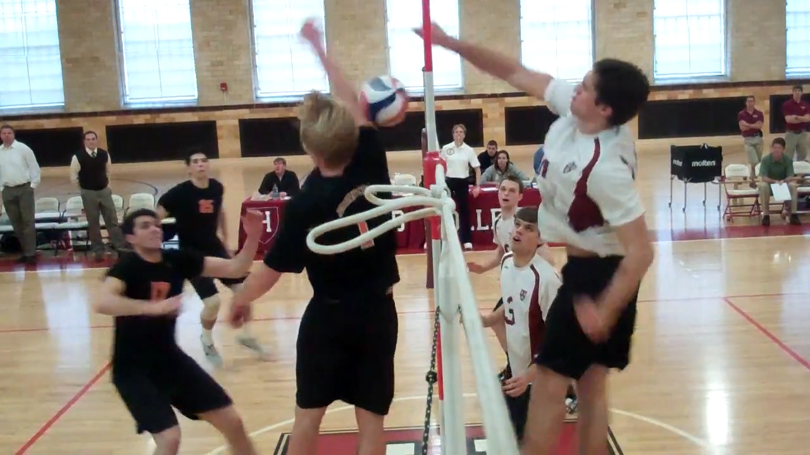
Back-Row Block
Rule 9-5-5c
NOTE: If a player near the net is reaching above the height of the net and opponents legally cause the ball to contact that player, the player is considered to be a blocker. A back-row player attempting to play a ball in the space directly above the net is considered an illegal blocker if the ball is attacked or blocked by an opponent into the back-row player while the player is reaching above the height of the net (including simultaneous contact).

Slide 18
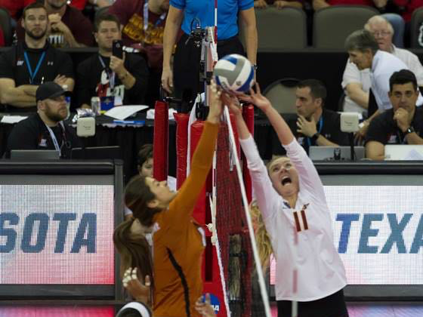

Slide 19
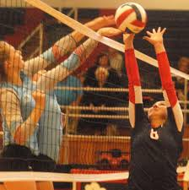
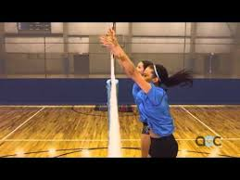
What is a Reach Over??

Slide 20
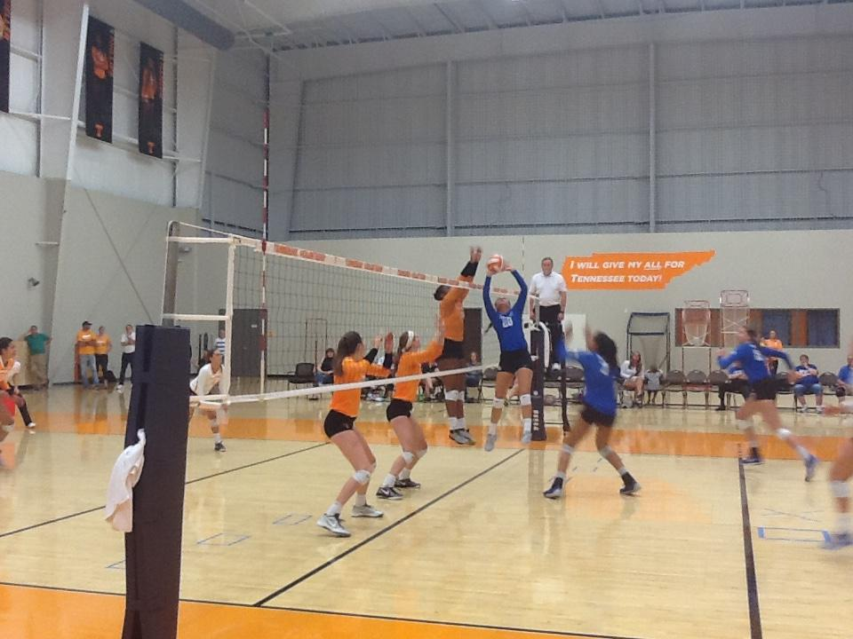

Slide 21
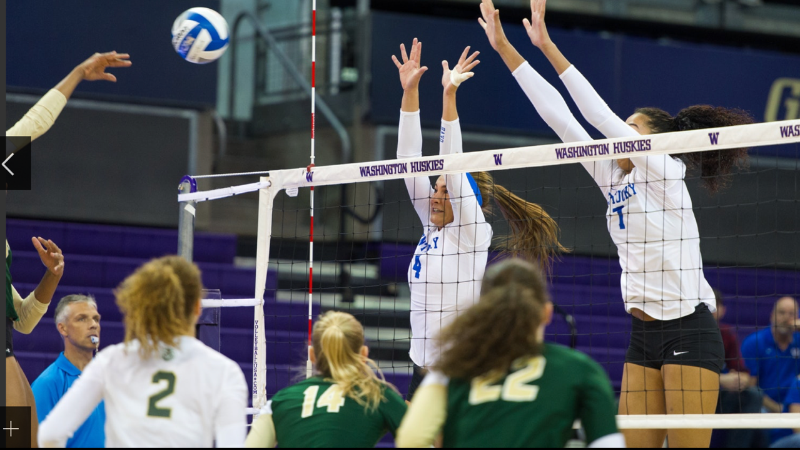
BLOCKING WITHIN THE OPPONENTS SPACE (REACH OVER)
RULE 9-6-3. A player shall not contact a ball which is completely on the opponent’s side of the net unless the contact is a legal block.
WHAT IS A LEGAL BLOCK OR A COMPLETED ATTACK?

Slide 22
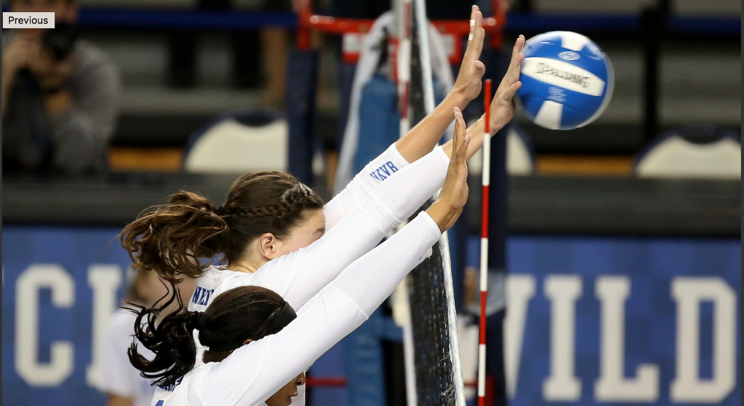
REACH OVER CONTINUED
RULE 9-6-4. Blocking a ball which is entirely on the opponent's side of the net is permitted when the opposing team has had an opportunity to complete its attack. The attack is considered complete when the:
Attacking team has completed its allowable hits;
Attacking team has had the opportunity to complete the attack or, in the referee’s judgment, directs the ball toward the opponent's court;
Ball is falling near the net and, in the referee’s judgement, no legal member of the attacking team could make a play on the ball.

Slide 23
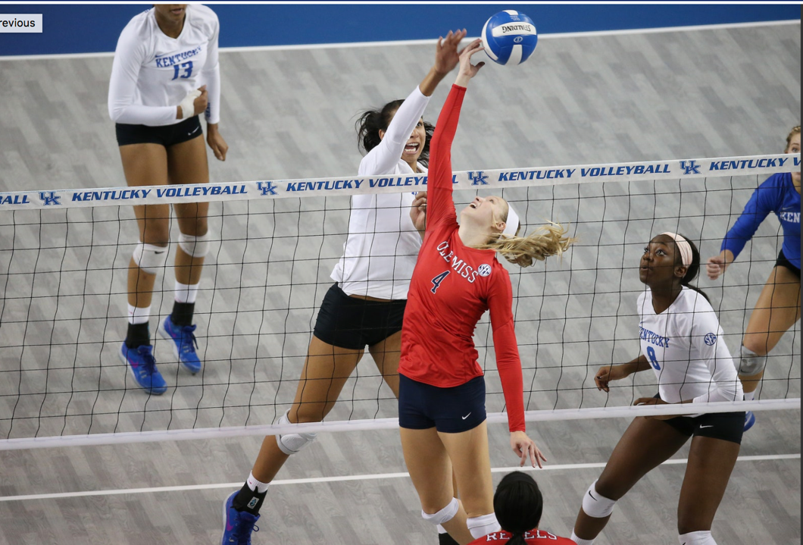

Slide 24
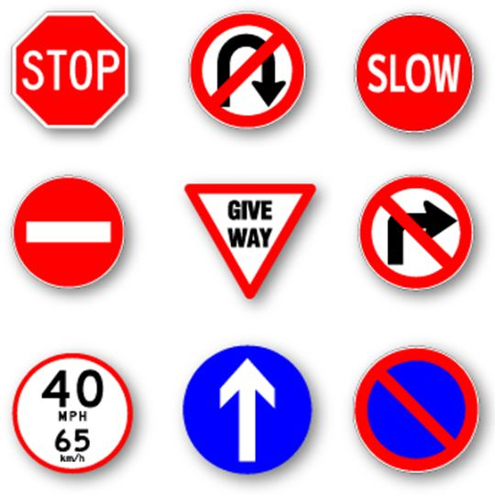
Informal Signals??

Slide 25
R1 Assist
Rule 5-5-3a: The second referee shall assist the first referee by ruling upon situations which are clearly out of the first referee's view. If assistance is provided, it should be done with a visual, informal signal.

Slide 26
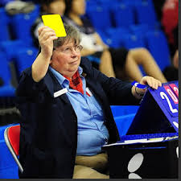
R1 Assist
Back Row player faults (BRB, BRA, 3 meter)
Out (which team?)
Libero overhead finger action in front zone
Four hits
Verify and confirm the 24th and 14th point
Unsporting conduct

Slide 27
THANK YOU

